Slide 1
All Figures
Bioinformatics Analysis of the Potentially Functional circRNA-miRNA-mRNA Network in Breast Cancer

Slide 2
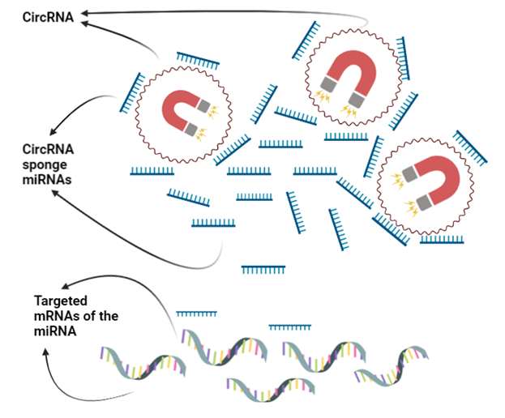
Fig. 1 The diagram of circRNA-miRNA-gene relationship

Slide 3
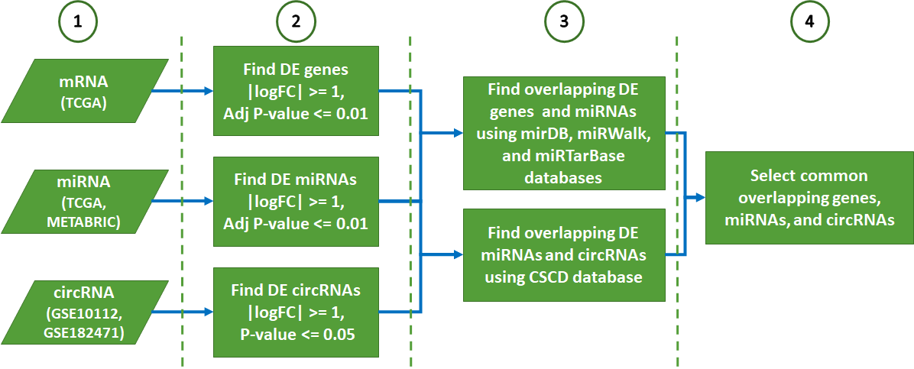
Fig. 2 The steps of the BC PAM50 subtype analysis. The miRNA–mRNA interactions were predicted with mirDB (v6), miRWalk (v3), and miRTarBase (Release 8.0). DE: Differentially expressed, CSCD(v2.0): Cancer-specific circRNAs database, BC: Breast Cancer.

Slide 4
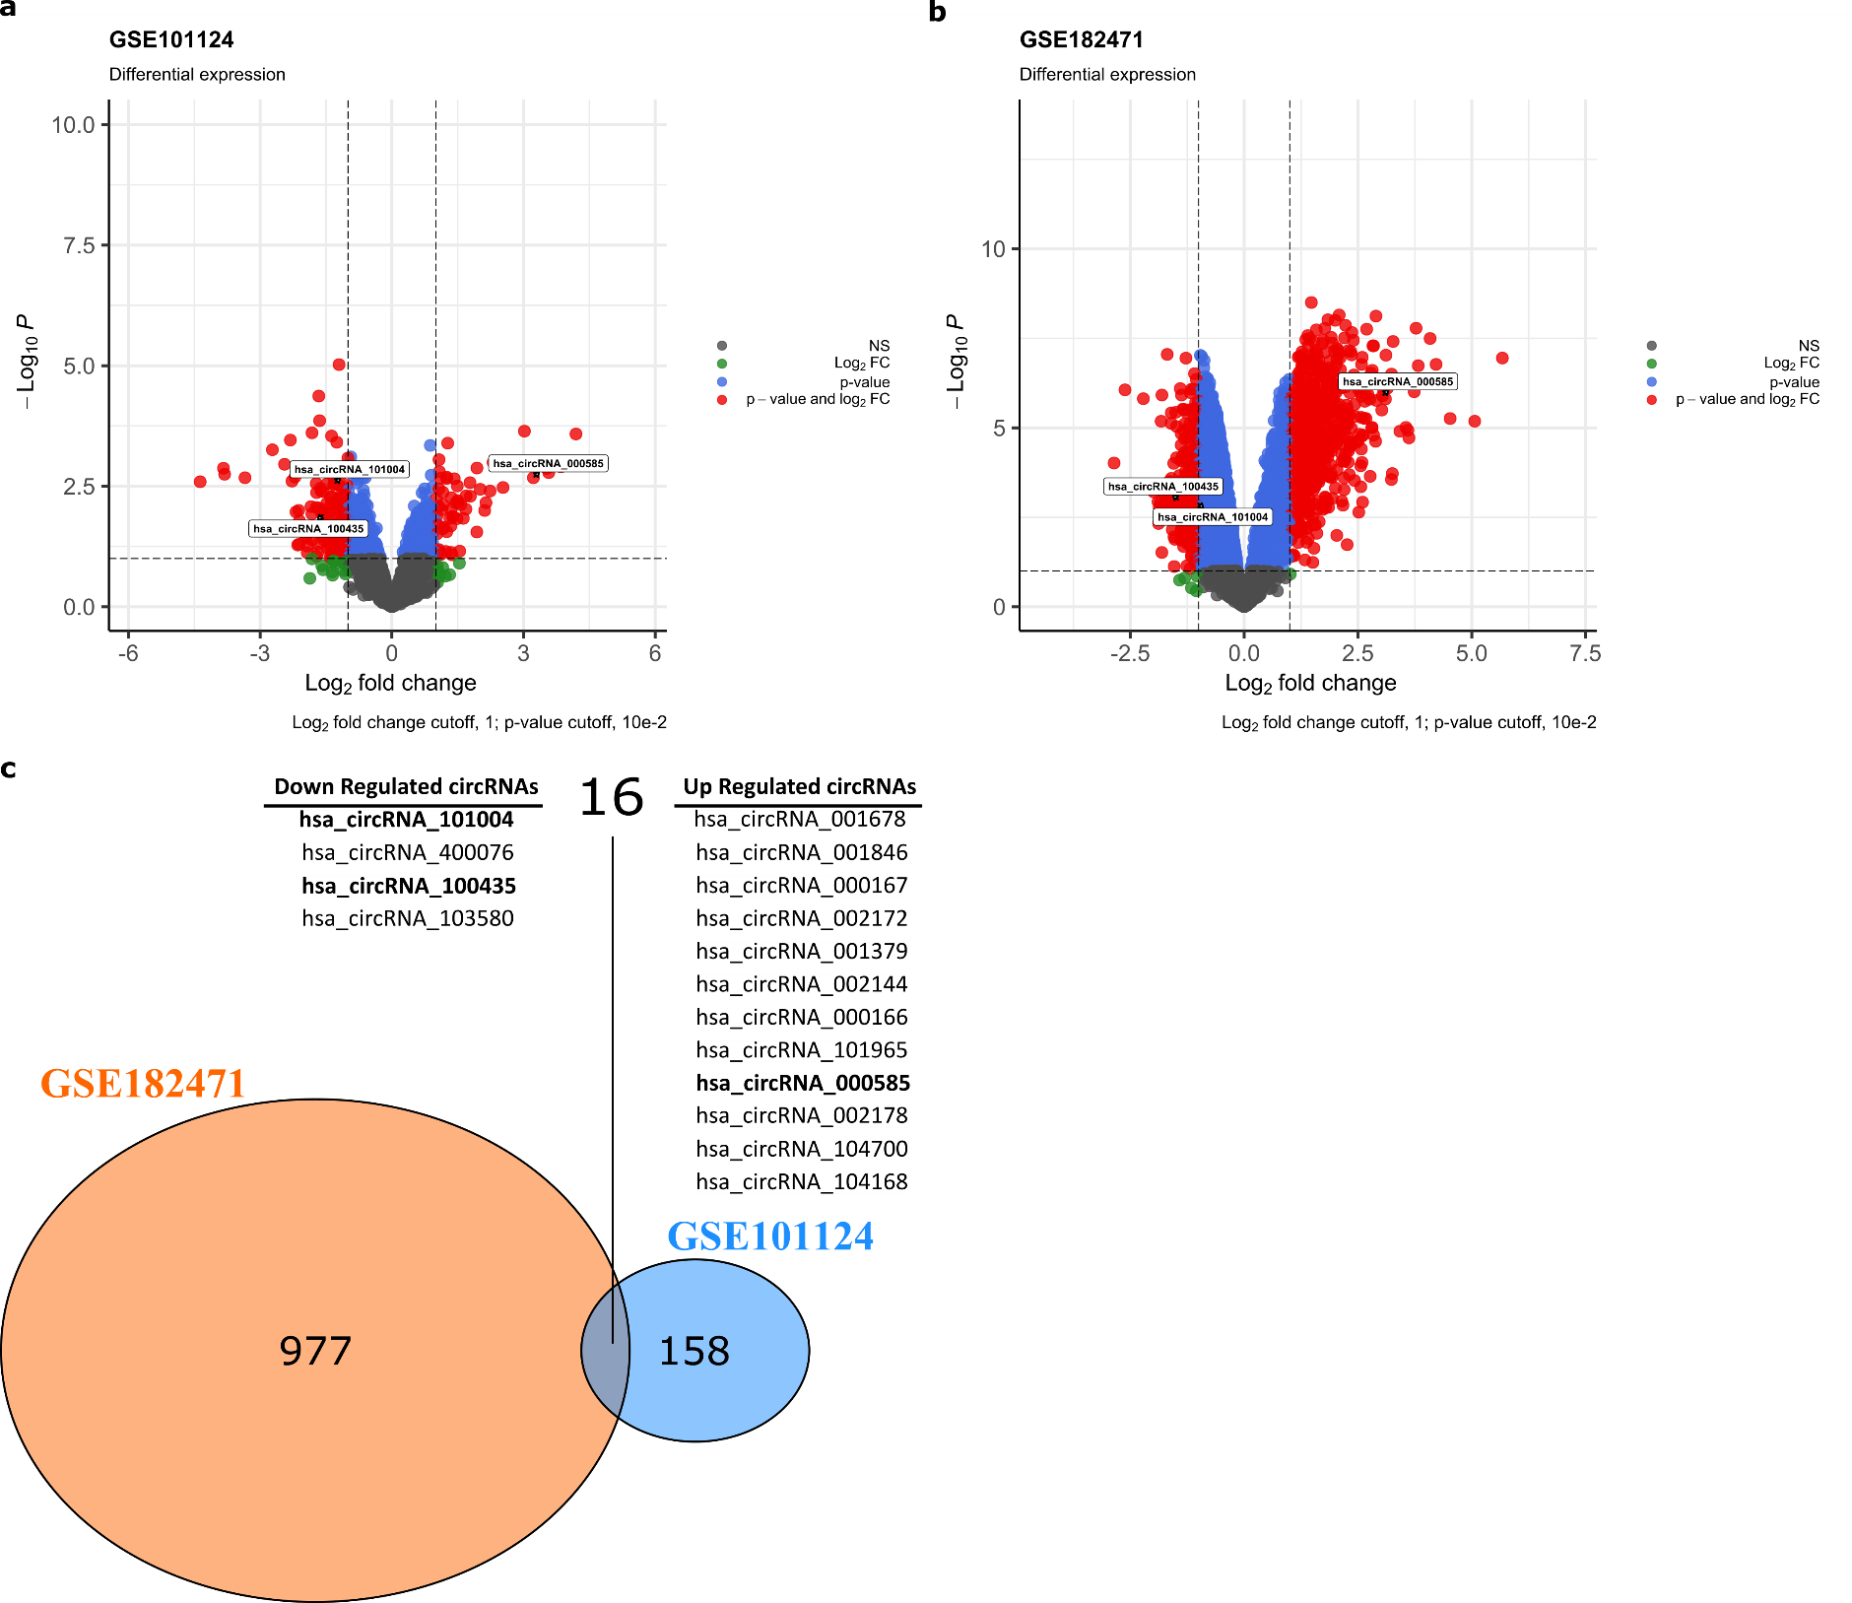
Fig. 3 The volcano plot for DECs in BC based on the two microarray datasets from GEO and intersected up- and down regulated circRNAs. a: GSE101124, b: GSE182471, c: The intersected up- and down-regulated circRNAs between the GSE101124 and the GSE182471 datasets. DECs: differently expressed circRNAs. BC: Breast cancer.

Slide 5
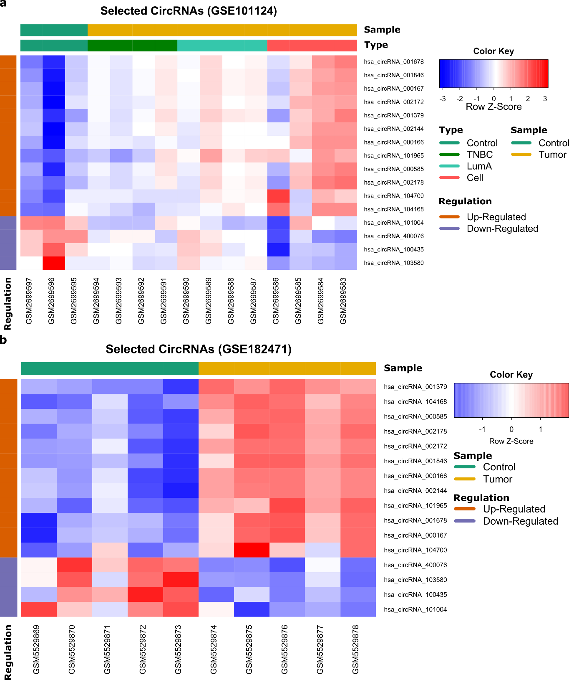
Fig. 4 Heatmap for the overlapped up- and down-regulated DECs in individual microarray datasets, a: GSE101124, b: GSE182471. The heatmap was generated by R package ‘gplots’. DECs: differently expressed circRNAs.

Slide 6
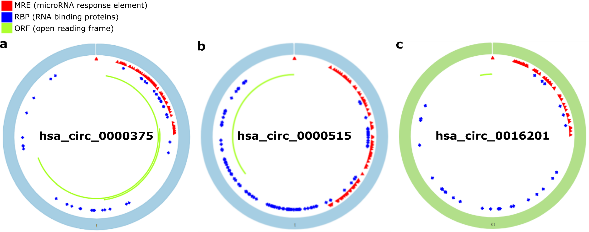
Fig. 5 Structural patterns of the three DECs by the Cancer-Specific CircRNA (CSCD v2.0, http://geneyun.net/CSCD2/), a: has_circRNA_0000375, b: has_circRNA_0000515, c: has_circRNA_0016201. DECs: differently expressed circRNAs.

Slide 7
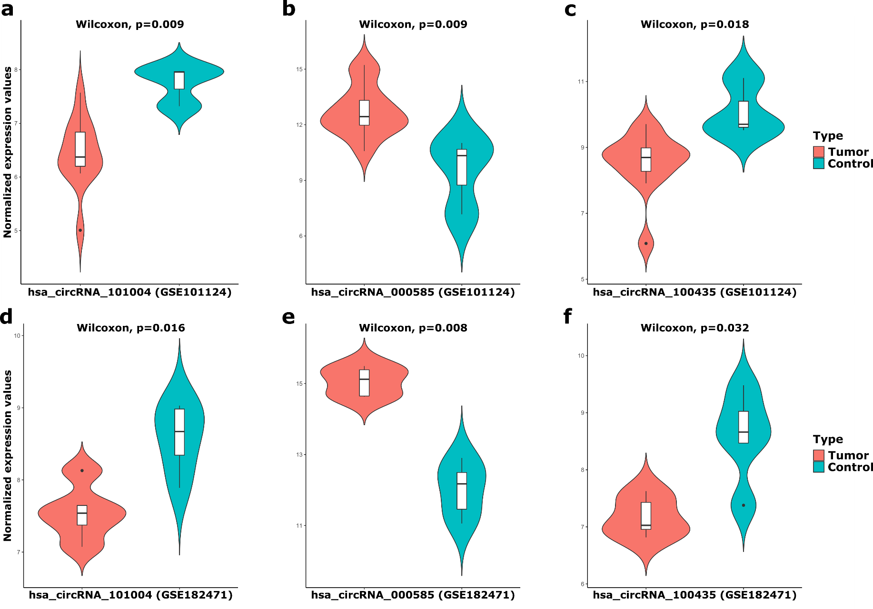
Fig. 6 The combined violin and box plots for the normalized expression values of hsa_circRNA_101004, hsa_circRNA_000585, hsa_circRNA_100435 in GSE101124 and GSE182471 datasets by the unpaired two-samples wilcoxon test according to tumor and control samples. a: hsa_circRNA_101004 in GSE101124, b: hsa_circRNA_000585 in GSE101124, c: hsa_circRNA_100435 in GSE101124, d: hsa_circRNA_101004 in GSE182471, e: hsa_circRNA_000585 in GSE182471, f: hsa_circRNA_100435 in GSE182471.

Slide 8
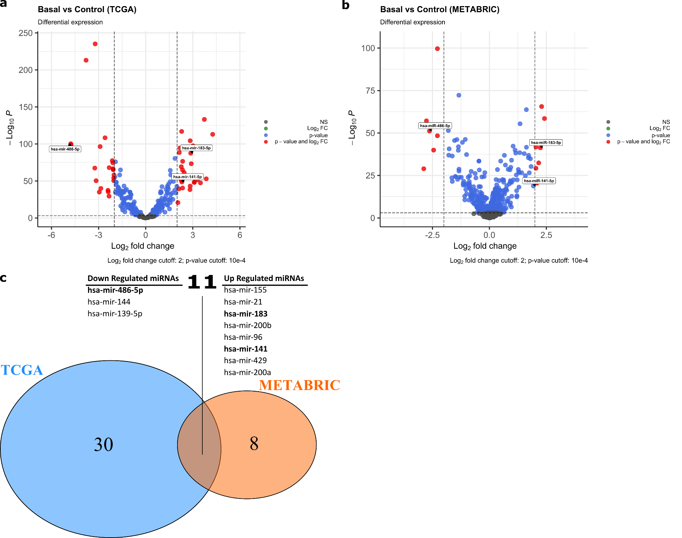
Fig. 7 The volcano plot for DEMs in BC based on the two microarray datasets from TCGA and EGA, and intersected up- and down regulated miRNAs a: TCGA, b: METABRIC, c: The intersected up- and down-regulated miRNAs from shared miRNAs in the TCGA and the METABRIC datasets, DEMs: Differentialy expressed miRNAs. EGA: European Genome-phenome Archive. BC: Breast cancer.

Slide 9
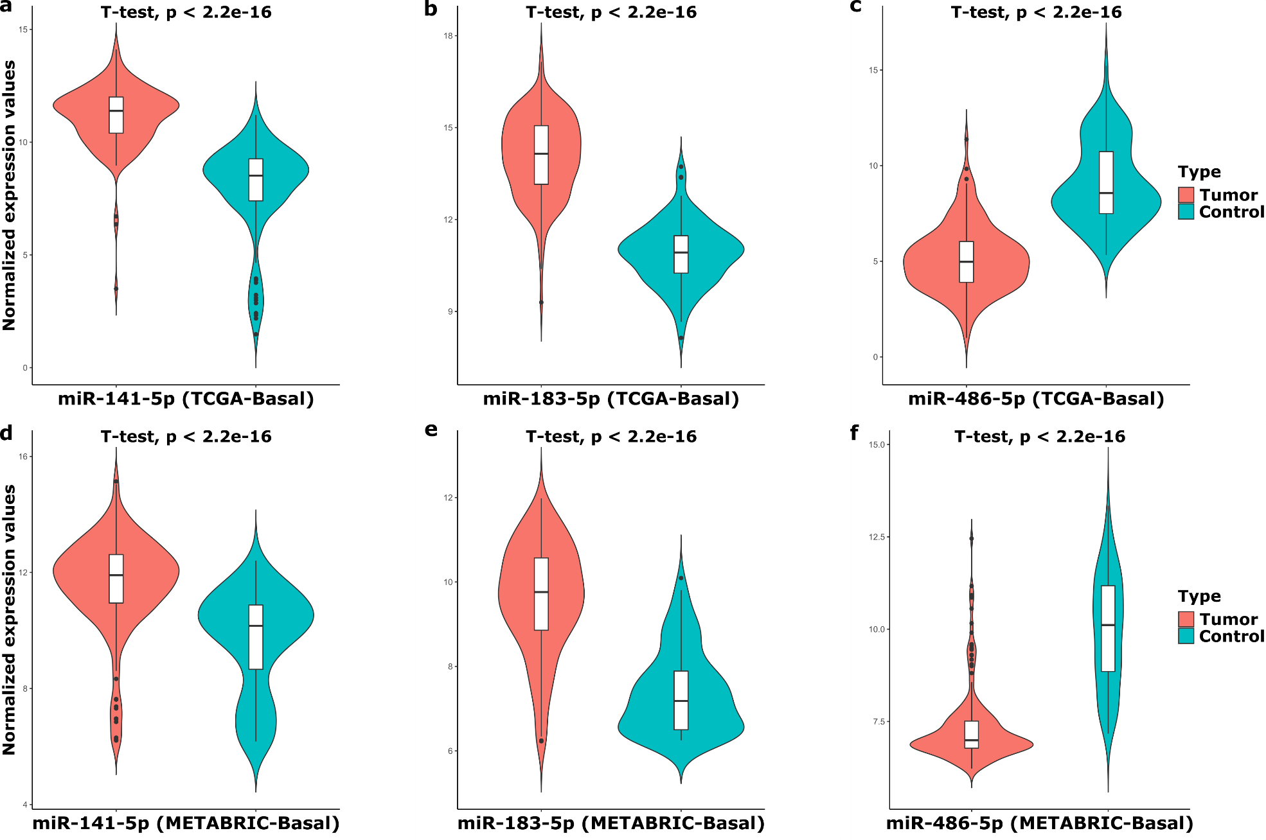
Fig. 8 The combined violin and box plots for the normalized expression values of miR-141-5p, miR-183-5p, and miR-486-5p in TCGA and METABRIC datasets by the unpaired two-samples t-test according to basal and control samples. a: miR-141-5p in TCGA, b: miR-183-5p in TCGA, c: miR-486-5p in TCGA, d: miR-141-5p in METABRIC, e: miR-183-5p in METABRIC, f: miR-486-5p in METABRIC.

Slide 10
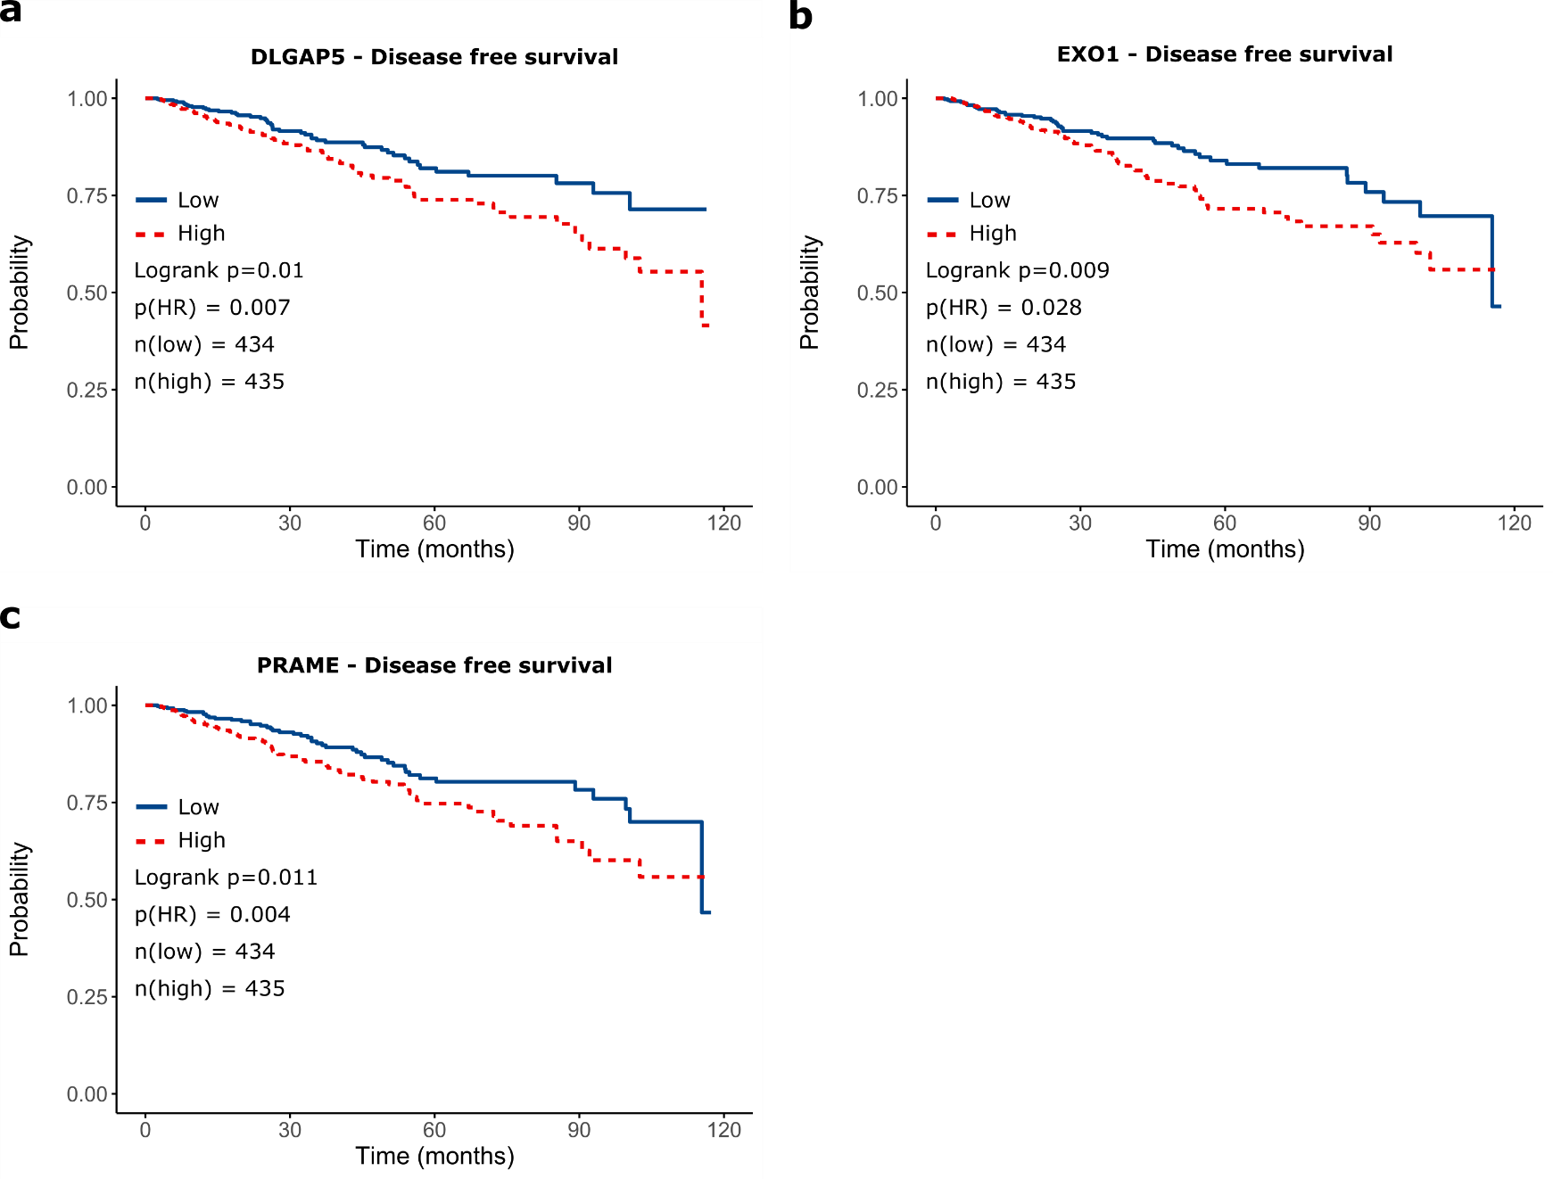
Fig. 9 Survival analysis of selected genes from TCGA. a: Disease-free survival of DLGAP5, b: Disease-free survival of EXO1, c: Disease-free survival of PRAME.

Slide 11
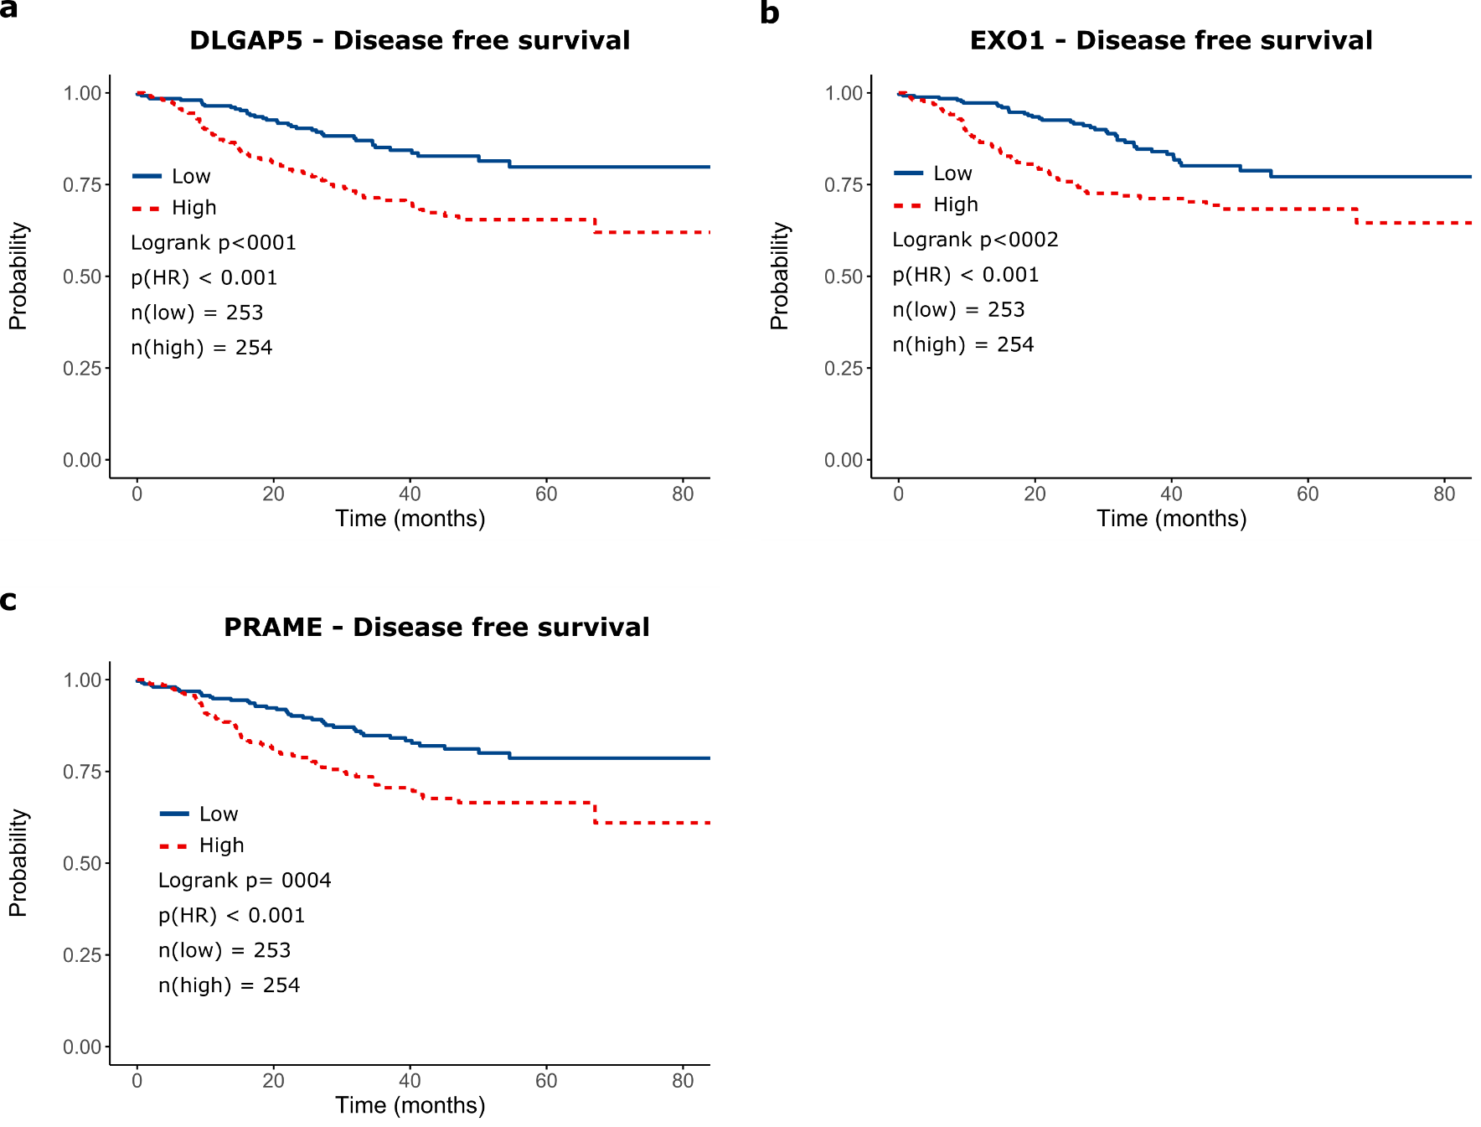
Fig. 10 Survival analysis of selected genes from GSE25066 dataset. a: Disease-free survival of DLGAP5, b: Disease-free survival of EXO1, c: Disease-free survival of PRAME.

Slide 12
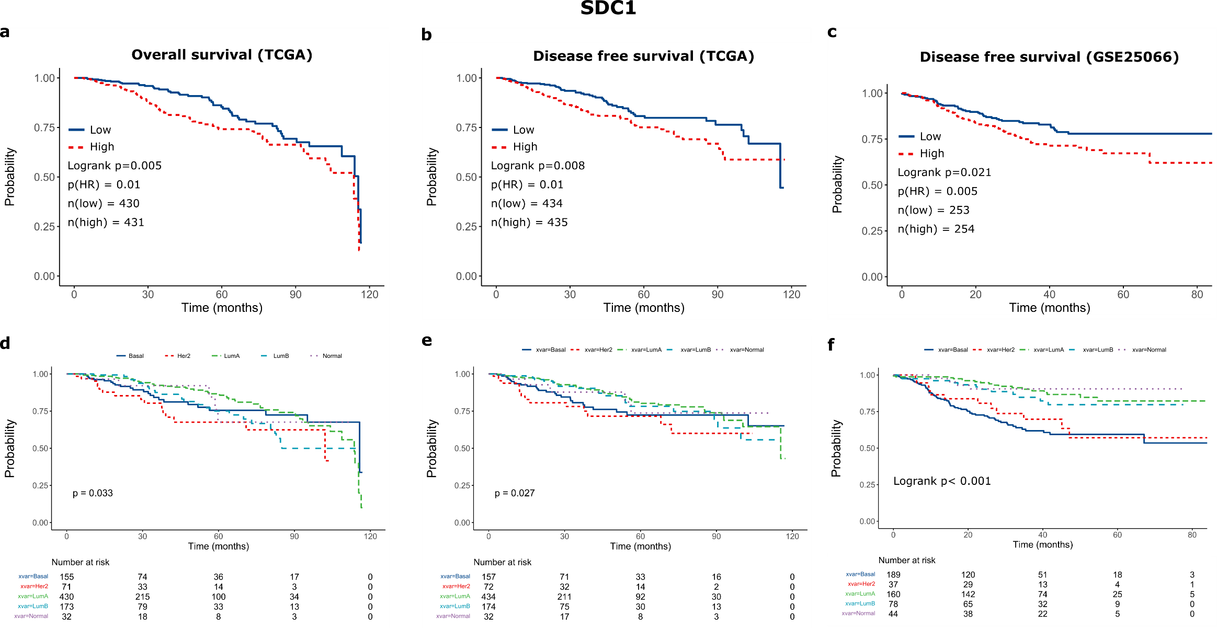
Fig. 11 Survival analysis of SDC1 gene from TCGA and GSE25066 datasets. a: Overall survival of BC in TCGA, b: Disease-free survival of BC in TCGA, c: Disease-free survival of BC in GSE25066, d: Overall survival of PAM50 subgroups in TCGA, e: Disease-free survival of PAM50 subgroups in TCGA, f: Disease-free survival of PAM50 subgroups in GSE25066.

Slide 13
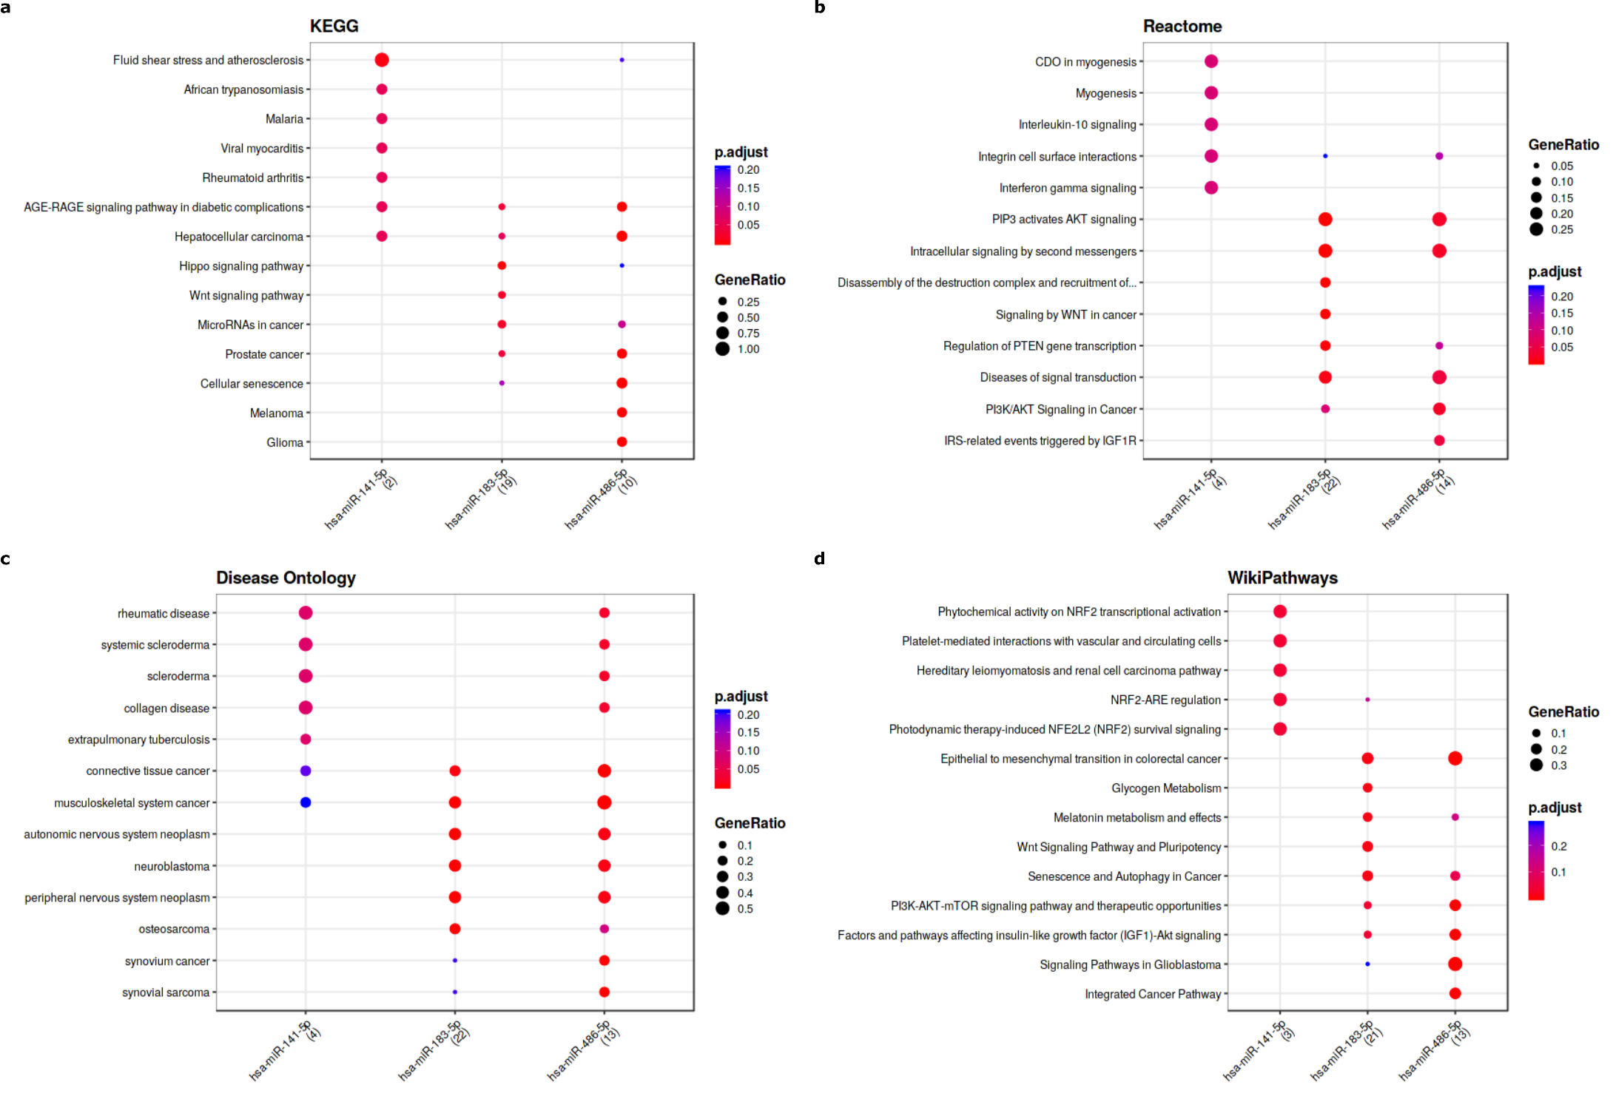
Fig. 12 Enrichment analysis results for the significant signaling pathways that the three miRNAs related according to the MIENTURNET (http://userver.bio.uniroma1.it/apps/mienturnet/). a: KEGG patways, b: Reactome pathways, c: Disease Ontology, d: WikiPathways.

Slide 14
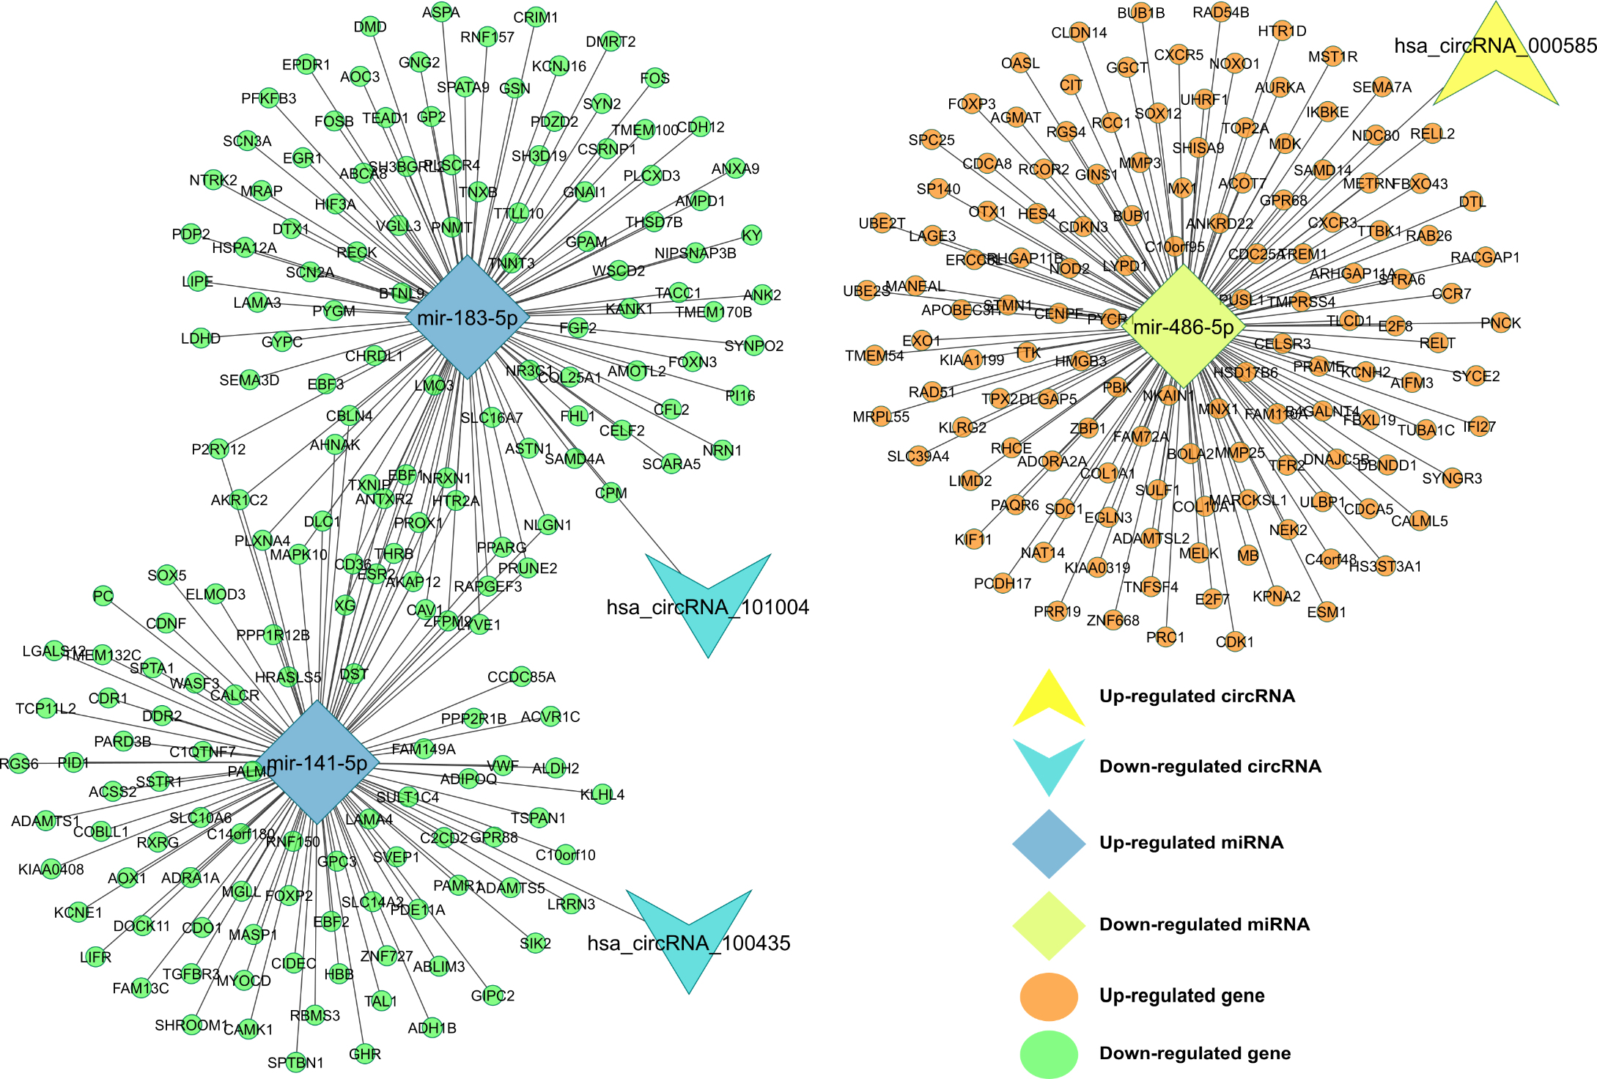
Fig. 13 circRNA–miRNA–mRNA regulatory network. The network consisting of three cricRNAs (hsa_circRNA_000585, hsa_circRNA_101004, and hsa_circRNA_100435), three miRNAs (miR-486-5p, miR-141-5p, and miR-183-5p) and 339 genes was generated by Cytoscape 3.9.0.

Slide 15
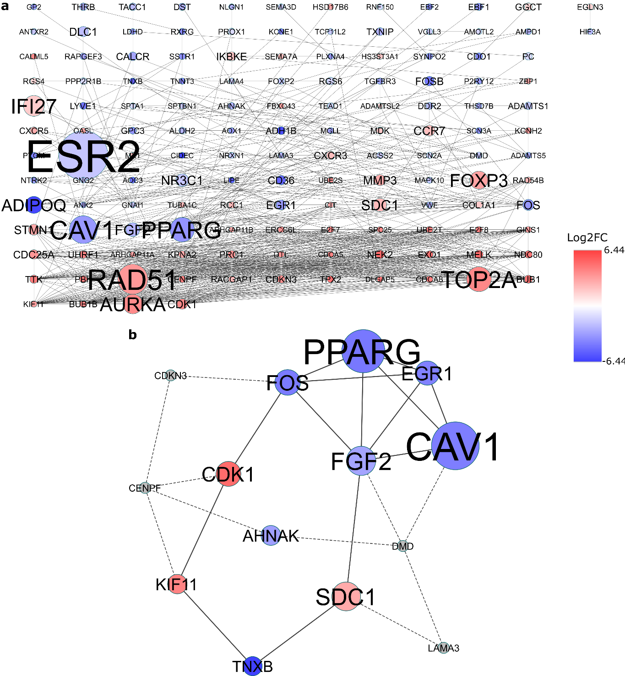
Fig. 14 Identification of hubgenes from the PPI network with the bottleneck algorithm using the cytoHubba [cite] Cytoscape plugin. The node color changes gradually from blue to red in ascending order according to the log2(foldchange) of genes. a: A PPI network of the 339 target genes that exert momentous roles in BC. This network consists of 138 nodes and 780 edges. The node size changes gradually from small to large in ascending order according to the number of the PMIDs from DisGeNET per gene. b: A PPI network of the 10 hubgenes (colored blue and red) and 4 extended genes (colored gray) that extracted from a. This network consists of 14 (10 hubgenes and 4 extended genes) nodes and 24 (14 between hubgenes and 10 between extended genes) edges. PPI protein–protein interaction, BC: Breast Cancer.

Slide 16
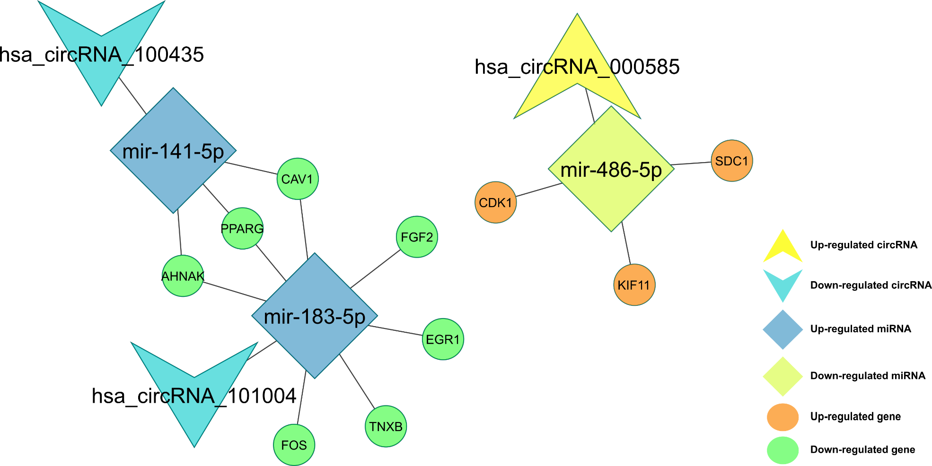
Fig. 15 CircRNA–miRNA–hubgene network. The network consisting of three cricRNAs (hsa_circRNA_000585, hsa_circRNA_101004, and hsa_circRNA_100435), three miRNAs (miR-486-5p, miR-141-5p, and miR-183-5p) and 10 hubgenes (AHNAK, CAV1, CDK1, EGR1, FGF2, FOS, KIF11, PPARG, SDC1, and TNXB) was generated by Cytoscape 3.9.0.

Slide 17
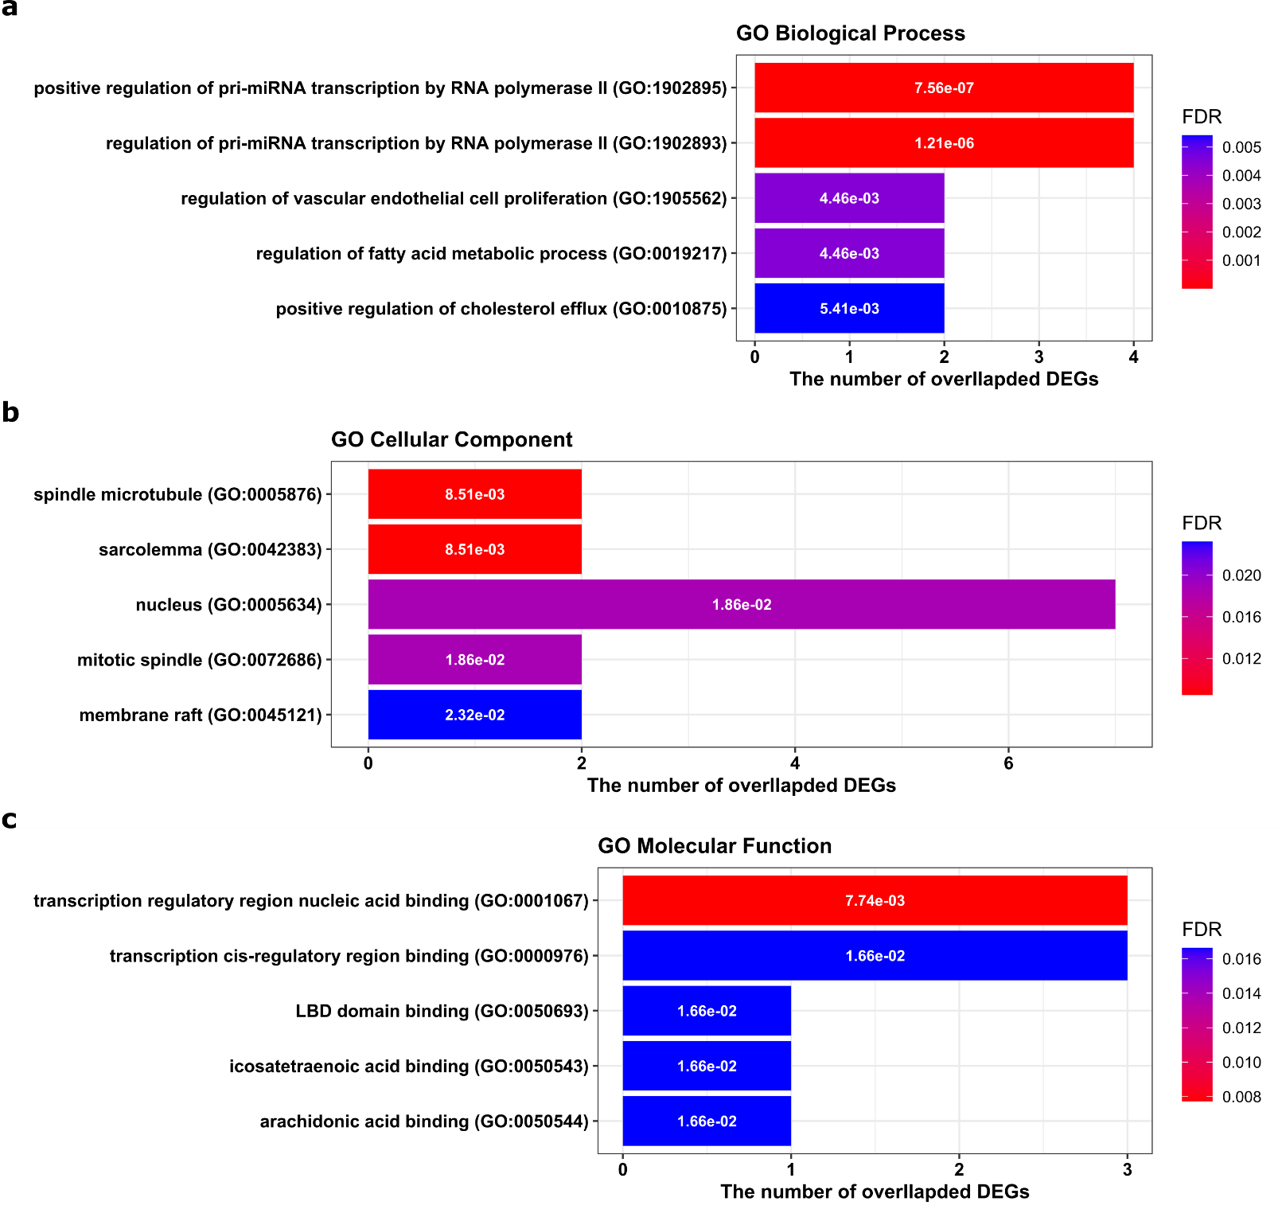
Fig. 16 Top five Gene Ontology (GO) enrichment annotations of the ten hubgenes: a: biological process, b: cellular component, c: molecularfunction. GO analysis was conducted by ‘Enrichr’ web tool (https://maayanlab.cloud/Enrichr/) and visualized by R package ‘ggplot2’. DEGs: Differentially expressed genes. FDR: False discovery rate, is an adjusted p-value calculated using the Benjamini-Hochberg method for correction for multiple hypotheses testing.

Slide 18
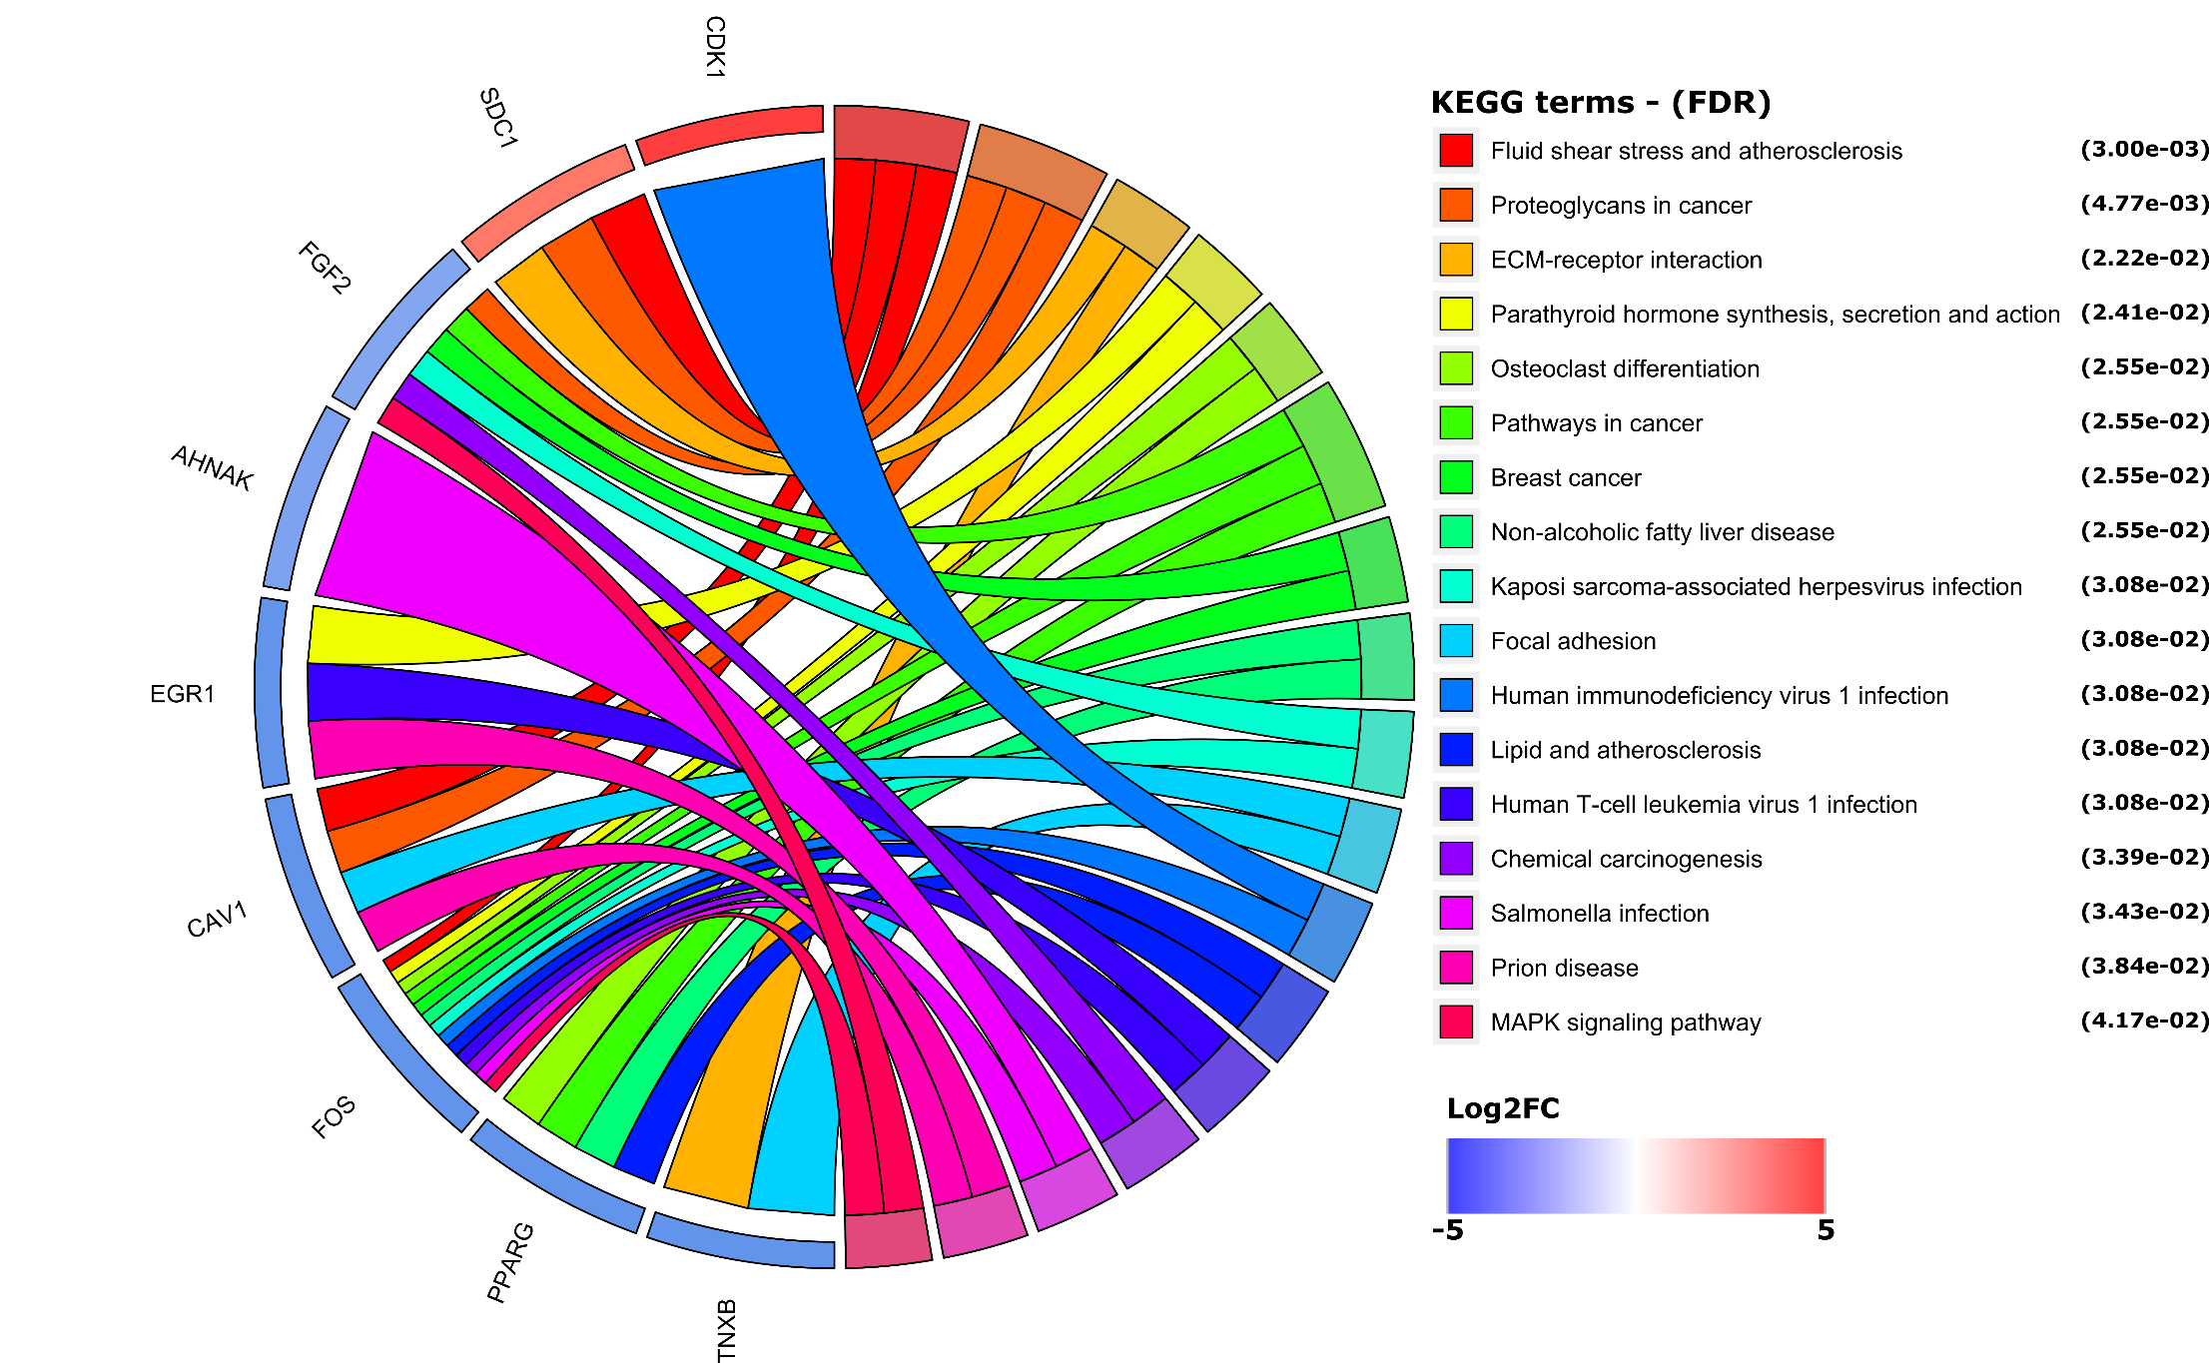
Fig. 17 The significantly enriched Kyoto Encyclopedia of genes and genomes (KEGG) pathways with a FDR < 0.05. KEGG analyze was conducted by ‘Enrichr’ web tool (https://maayanlab.cloud/Enrichr/) and visualized by R package ‘ggplot2’. Cohort plot shows that the ten hub genes are correlated via ribbons with their assigned KEGG terms. FDR: False discovery rate, is an adjusted p-value calculated using the Benjamini-Hochberg method for correction for multiple hypotheses testing.

Slide 19
Fig. 18 The summary of possible role of circRNA/ miRNA/ gene axis in BC pathogenesis according to our study.

